Slide 1
The Priesthood of Christian
基督徒祭司的职份

Slide 2
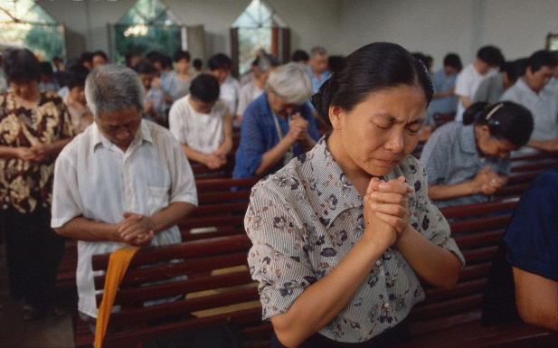
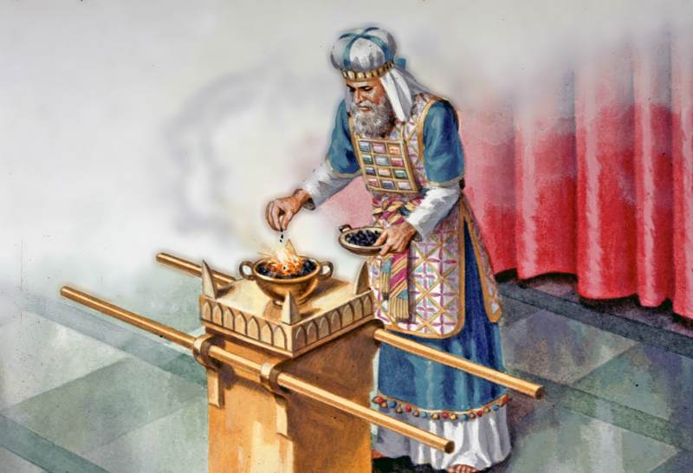
基督徒Christian vs. 祭司Priest

Slide 3
基督徒祭司的身份 (the Priesthood of Christian) (1 Peter 2:9)
过去 the Past – 出Exod 19：6 “你们要归我作祭司的国度、为圣洁的国民” you shall be to me a kingdom of priests and a holy nation
现在 the Present –彼前 1 Pet 2：9“惟有你们是被拣选的族类、是有君尊的祭司、是圣洁的国度、是属 神的子民、叫你们宣扬那召你们出黑暗入光明者的美德”。”But you are a chosen race, a royal priesthood, a holy nation, a people for his own possession, that you may proclaim the excellences of him who called yu out of darkness into his marvelous light.”
将来 the Future – 启Rev. 5：9、10“。。。从各族各方、各国中买了人来、叫他们归於 神、又叫他们成为国民、作祭司、归於神、在地上执掌王權””you ransomed people for God from very tribe and language and people and nation and you have made them a kingdom and priests to our God, and they shall reign on the earth.”

Slide 4
祭司的约the covenant of Priest – 生命和平安的约 the Covenant of Life and Peace (玛Malachi2：5-7）
祭司职责的内容 (利 Lev 10：8-10):
关乎生命 Life - 分别圣俗、洁净与不洁净 与献平安与燔祭distinguish the holy and the common and between the unclean and clean, and offer burn and peace offerings
关乎平安 Peace - 教导律例典章、使得多人离开罪恶与献赎罪祭 teach the people of Israel all the statues of the Lord and turn many from iniquity, and offer Sin and Guilt offerings
Mediator between God and Man
Interceded on behalf of people

Slide 5
祭司的职分对今日的我们的意义 What does it mean to us today as Priesthood

Slide 6
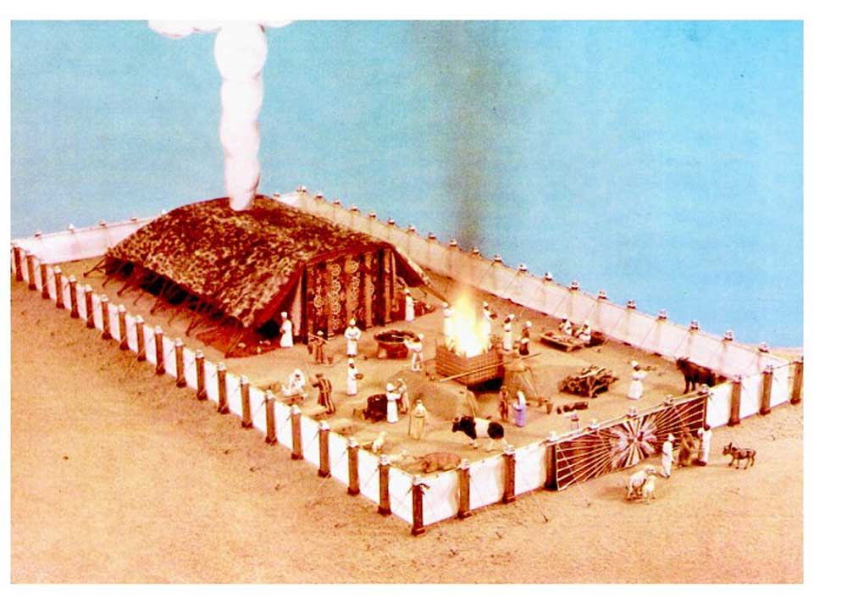
会幕Tabernacle

Slide 7
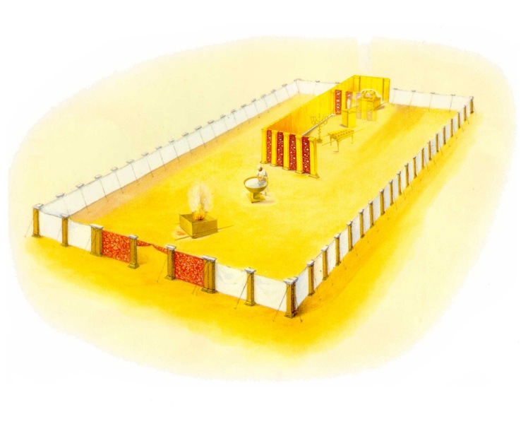
圣所的圣物 Holy items of Tabernacle

Slide 8
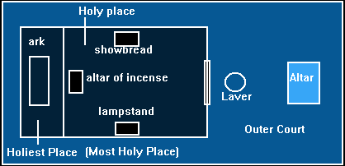
圣物的安排 The arrangement of Holy items

Slide 9
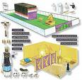
基督在会幕圣物的预表 (Seeing CHRIST in the Tabernacle)

Slide 10
祭司日常的服事Routine Service of a priest
1. 献祭 offer sacrifies
献燔祭与平安祭 Burn Offerings and peace offerings
早、晚都要献in the Morning and at twilight（出Exod 29:38-39 vs 罗 rom. 12：1-2）
坛上的火要常常烧着、不可熄灭 The fire on the altar shall be kept burning on it and shall not go out.（利Lev. 6：12 vs. 罗 rom. 12:11）
B. 赎罪祭、赎愆祭（利Lev 4：1 vs 加 gal. 6:1-5）- 误犯时所献的祭

Slide 11
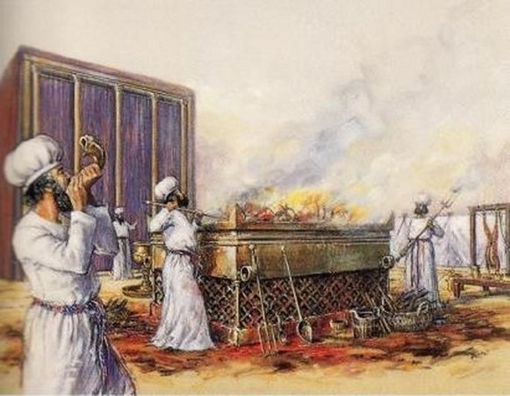
如何献 燔祭Burn Offering

Slide 12
圣所的服事 serving in the Holy Place
洗濯盆the basin of bronze（出Exod. 30：17）
灯要常常点着 （利Lev. 24：2）-都向 灯台前面发光the seven lamps shall give light in the front of the lampstand (民 Num 8:2) vs. 太 Matt 5:15-16、可 Mark 4：21）
香坛 the Altar of Incense （出Exd.30：7）- 收拾灯时要烧馨香料的香burn incense when he dress the lamp in the morning and at twilight vs. 路 Luke 1:8，9、启Rev. 5:8、8：3）
每安息日要换陈设饼（renew the showbread on Sabbath) 利 Lev。24：5-9 vs

Slide 13
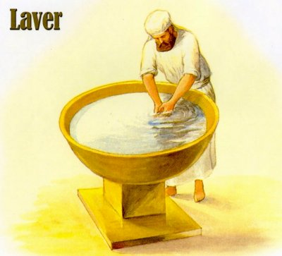
Before we serve in the Holy Place

Slide 14
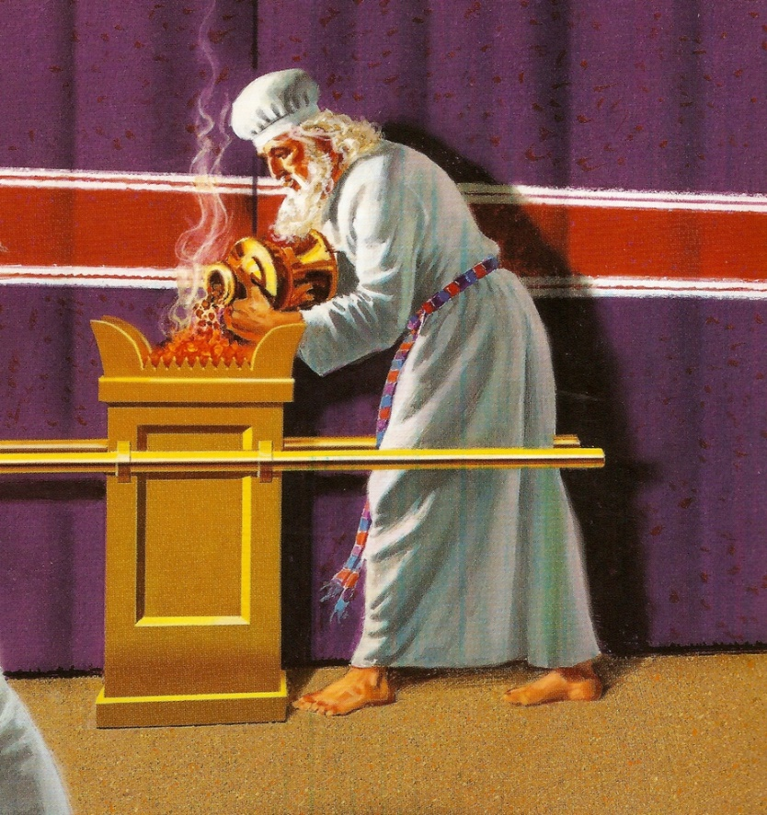
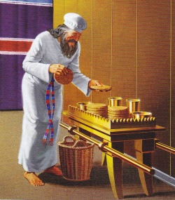
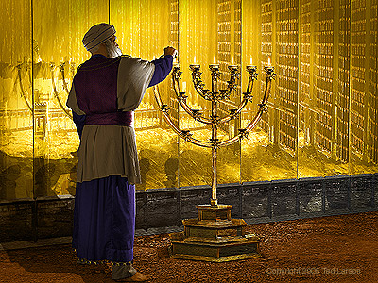
How we dress the Lamps

Slide 15
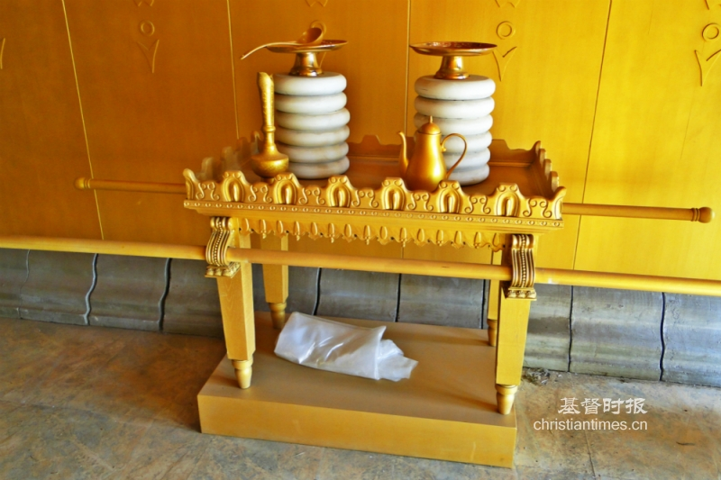
如何献陈设饼How we offer the bread of presence (Showbread)

Slide 16
3. 教导神的律例使得人转离恶道Teaching the Statues of the Lord, turn many from iniquities. (利 Lev。 10：8-10 vs。来heb. 3:12-13、林後5；19-21）

Slide 17
与神相会之处 Meeting with God at:
祭坛 Altar of Burn Offering（出Exod. 29：42）
燔祭 (burn offering)
平安祭 （peace offering）
香坛 Altar of Incense（出Exod 30：36）
施恩座 Mercy seat, throne of grace（出Exod. 30：6、希Heb 4：16、10：19）
为要得怜恤（Receive Mercy)
蒙恩惠（Find Grace)
作随时的帮助(to help in Time of Need)
抵挡魔鬼（彼前5：7-9、雅4：7）
面对试探（林前10：13）
魔鬼的目的是Paralyze(僵化）基督徒与教会、失去本位。不是要我们否认上帝的存在、而是ineffectiveness.)

